Slide 1
Code Faster and More Effectively with C# 11
Kathleen Dollard
@KathleenDollard

Slide 2


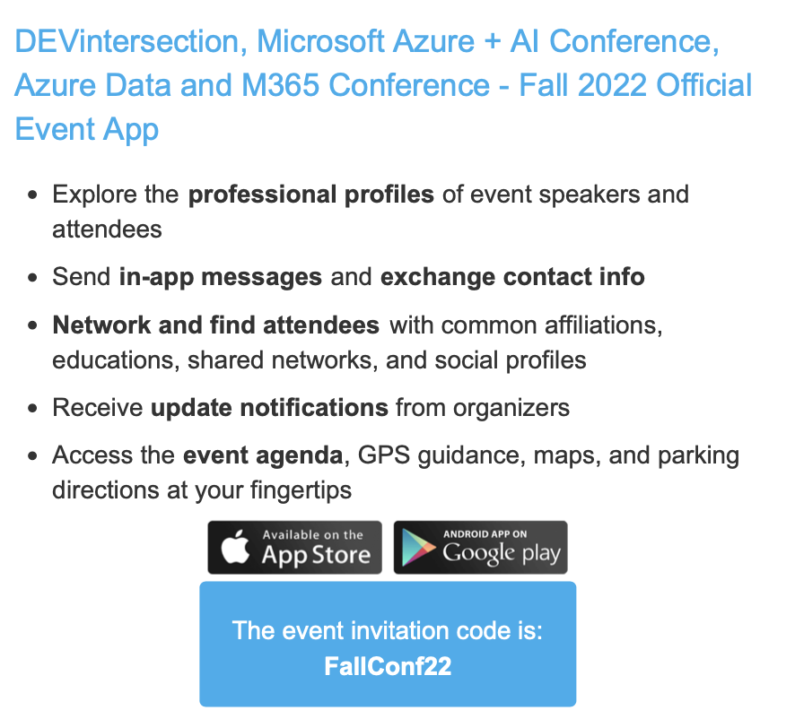

Slide 3
Why do we innovate in C#?
Productivity
Readability
Expressing your intent/correct code
Faster applications

Slide 4
Feature journeys
Strings
Immutability
Patterns
Unsafe with guardrails
ref and span - you benefit without even using
The nature of types
Static methods in interfaces
Upcoming work for C# 12

Slide 5
Stuff without examples
Static interfaces in methods
Checked and unchecked user defined operators
User defined operators can respect checked scope
File local types (especially for generators)
Improvements to ref
ref fields and scoped ref
nint and nuint aliases for IntPtr and UIntPtr
Operators are now checked
Improved caching for method group conversions

Slide 6
C# 12
The source of truth:
roslyn/Language Feature Status.md at main · dotnet/roslyn (github.com)
Thanks to @JCouv and@333Fred
Look for docs at or shortly after each preview
Search for “Whats new in C# 12” after next Visual Studio update in Feb
Thanks to @BillWagner

Slide 7
Semi-auto property conundrum A breaking change because change in code meaning
Semi-Auto-Properties; `field` keyword · Issue #
Keywordness of `field` · Issue #6530
Only Allow Lexical Keywords in the Language · Issue #4460
One way to let developers choose upgrade warnings per project
LangVersion – compiler rules as today
LangCompatVersion – the version you aspire to or are moving from
LangVersion > LangCompatVersion – warnings on breaking changes between versions
LangCompatVersion < LangVersion – you can prepare for the update
LangVersion == LangCompatVersion – maintenance, no update warnings

Slide 8
References (feel free to take a photo)
Code for today’s talk https://github.com/KathleenDollard/csharp11
Roslyn Feature Status: https://github.com/dotnet/roslyn/blob/main/docs/Language Feature Status.md
What’s new in C# 11 https://learn.microsoft.com/en-us/dotnet/csharp/whats-new/csharp-11

Slide 9
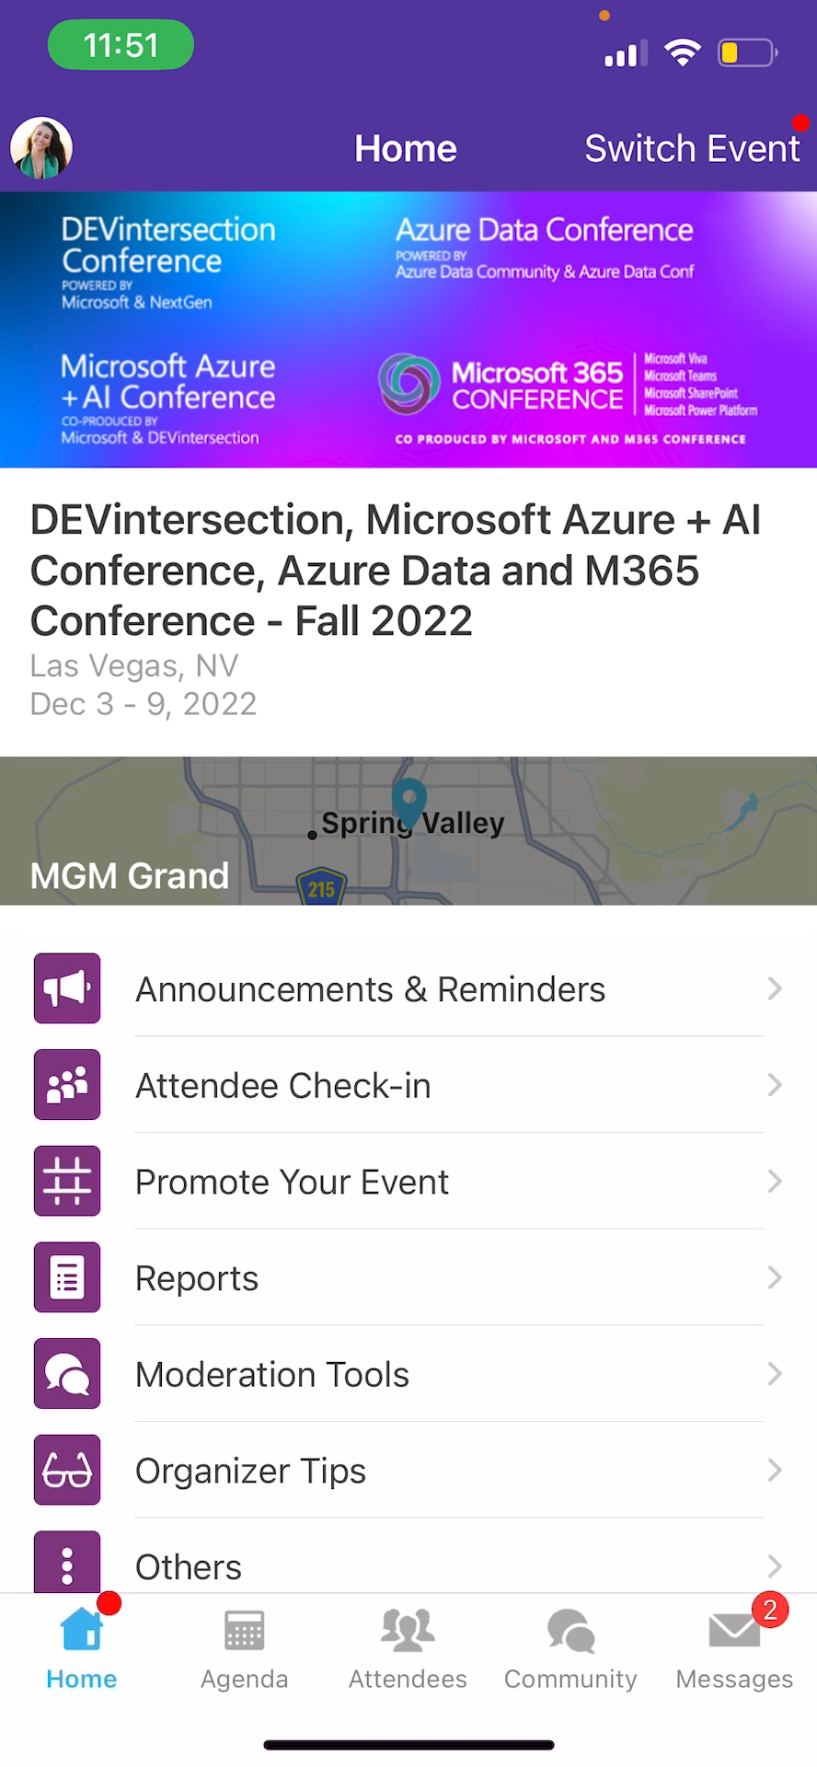
Session Feedback Surveys
In the pursuit of making our conferences even better, we need to hear your feedback about this session.
Here’s How -
Simply go to the Whova App on your smartphone
Go to the conference homepage
Scroll down to ‘Additional Resources’ and click ‘Surveys’.
Click ‘Session Feedback’.
Scroll down to click on this session title.
Complete the session feedback survey.
Finally, click ‘Submit’

Slide 10


